Slide 1
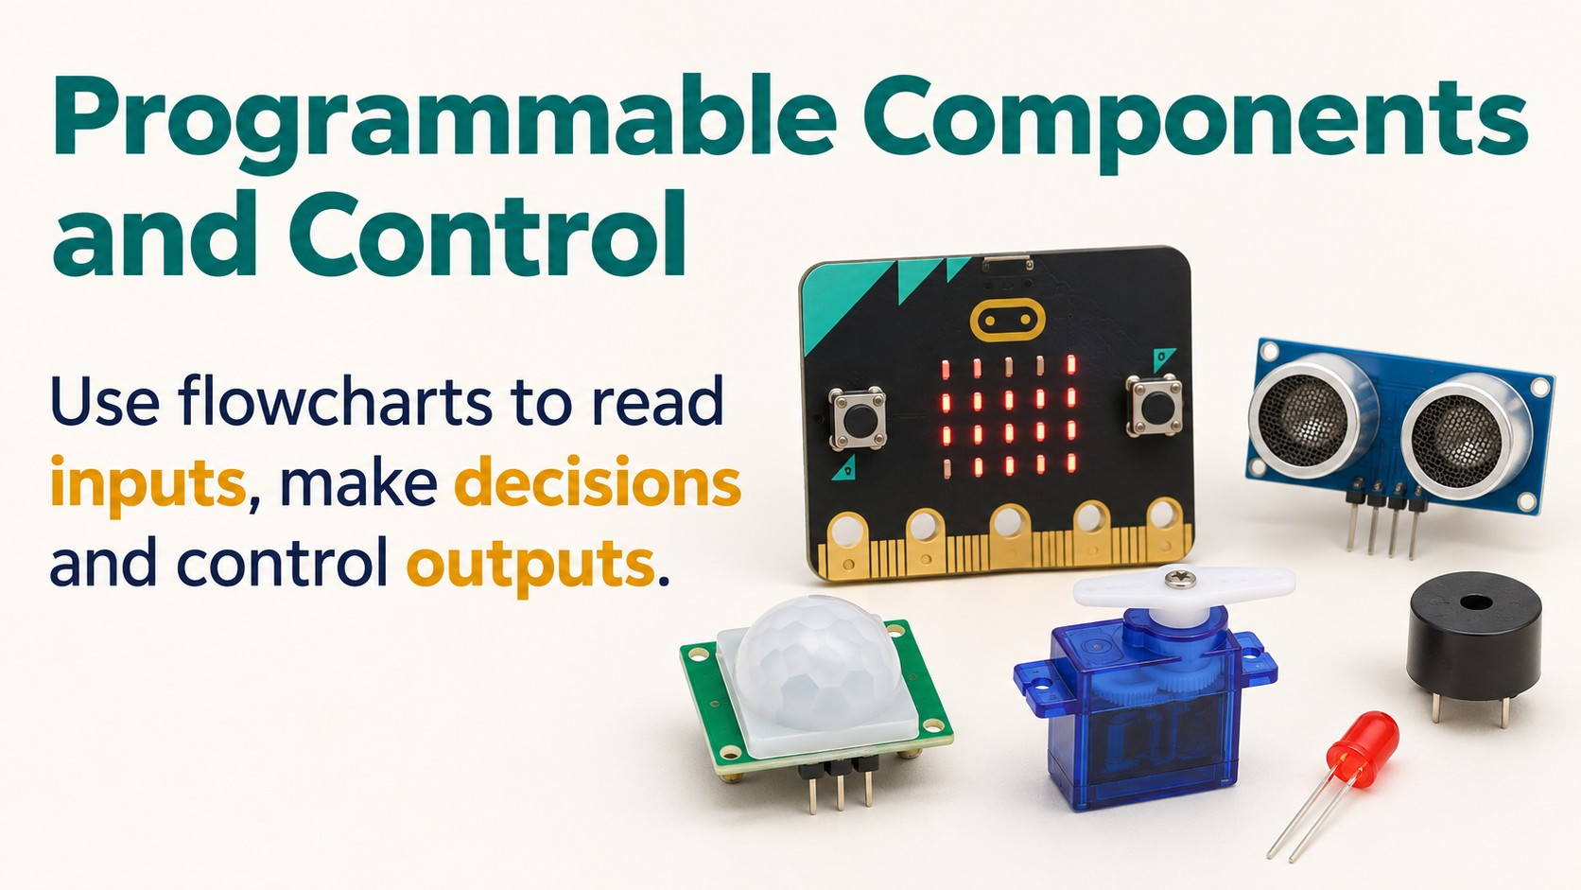
Notes:
Source: Pearson Edexcel GCSE (9–1) Design and Technology reference PDF, section 1.6 Electronic systems, printed pages 23–24, and section 1.7 The use of programmable components, pages 24–26. Classroom adaptation of approved content. Generated visuals are illustrative and are not wiring instructions. High/Low output behaviour and Wait units depend on the controller and software.

Slide 2
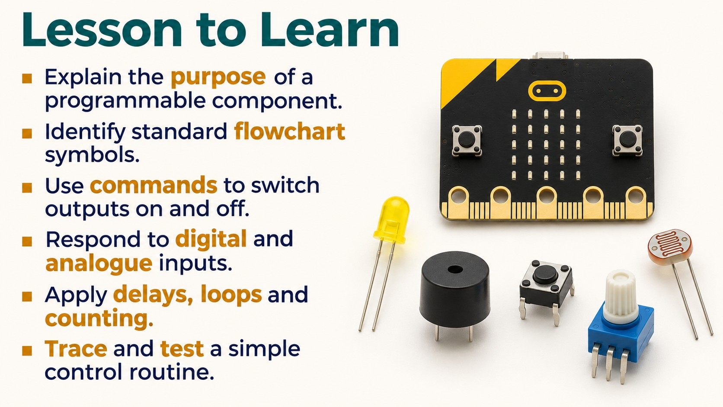
Notes:
Source: Pearson Edexcel GCSE (9–1) Design and Technology reference PDF, section 1.6 Electronic systems, printed pages 23–24, and section 1.7 The use of programmable components, pages 24–26. Classroom adaptation of approved content. Generated visuals are illustrative and are not wiring instructions. High/Low output behaviour and Wait units depend on the controller and software.

Slide 3
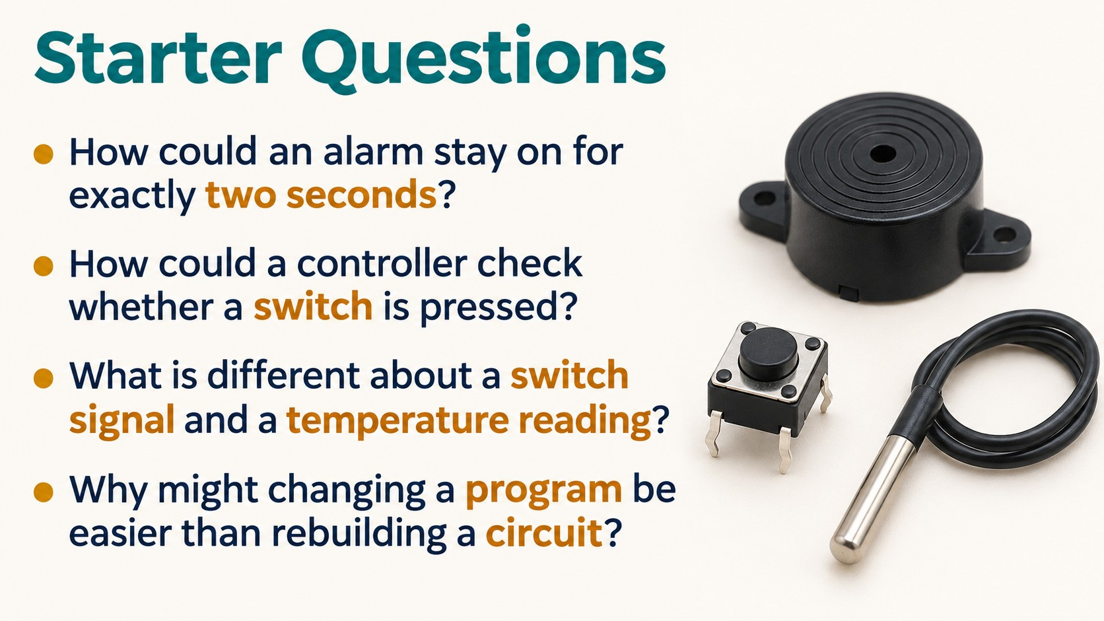
Notes:
Source: Pearson Edexcel GCSE (9–1) Design and Technology reference PDF, section 1.6 Electronic systems, printed pages 23–24, and section 1.7 The use of programmable components, pages 24–26. Classroom adaptation of approved content. Generated visuals are illustrative and are not wiring instructions. High/Low output behaviour and Wait units depend on the controller and software.

Slide 4
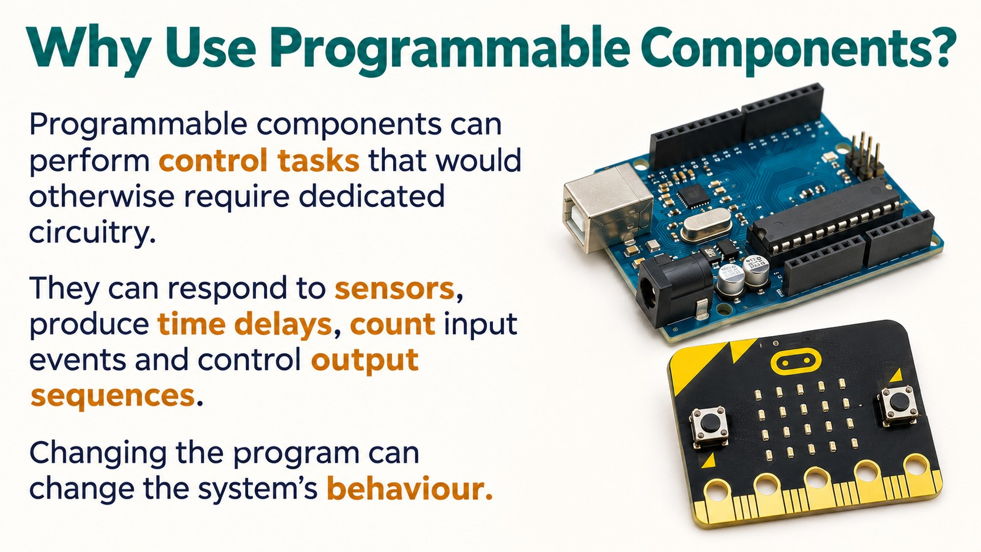
Notes:
Source: Pearson Edexcel GCSE (9–1) Design and Technology reference PDF, section 1.6 Electronic systems, printed pages 23–24, and section 1.7 The use of programmable components, pages 24–26. Classroom adaptation of approved content. Generated visuals are illustrative and are not wiring instructions. High/Low output behaviour and Wait units depend on the controller and software.

Slide 5
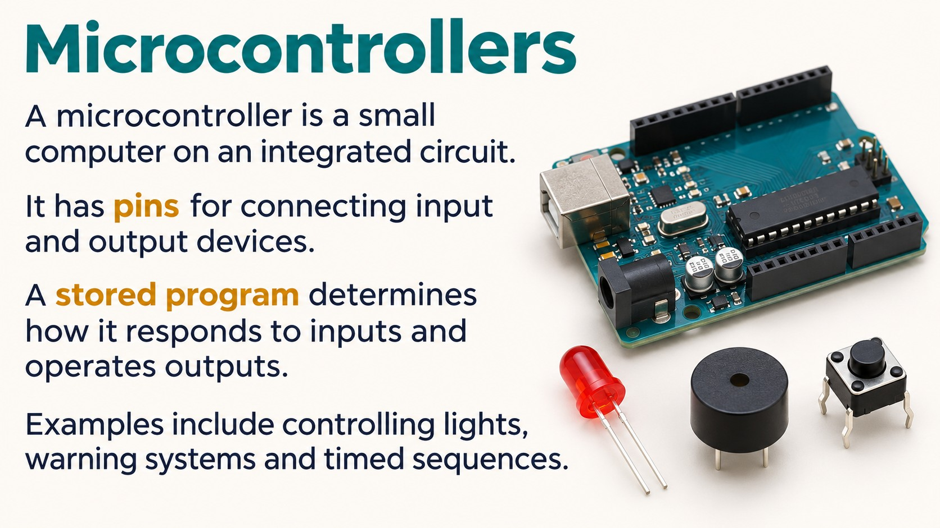
Notes:
Source: Pearson Edexcel GCSE (9–1) Design and Technology reference PDF, section 1.6 Electronic systems, printed pages 23–24, and section 1.7 The use of programmable components, pages 24–26. Classroom adaptation of approved content. Generated visuals are illustrative and are not wiring instructions. High/Low output behaviour and Wait units depend on the controller and software.

Slide 6
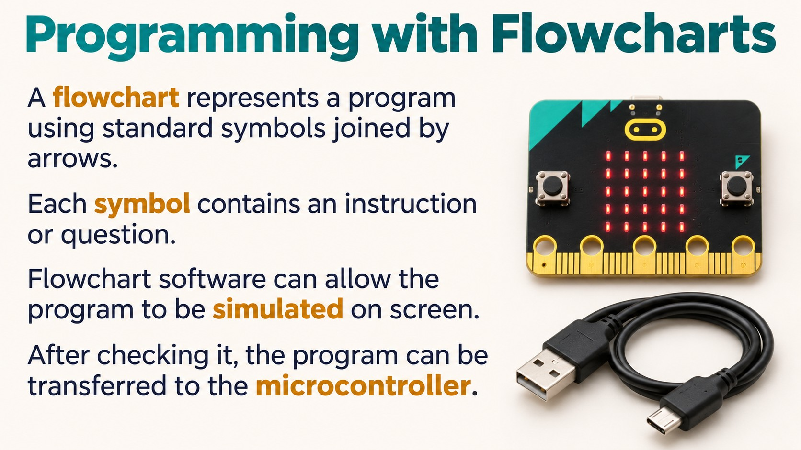
Notes:
Source: Pearson Edexcel GCSE (9–1) Design and Technology reference PDF, section 1.6 Electronic systems, printed pages 23–24, and section 1.7 The use of programmable components, pages 24–26. Classroom adaptation of approved content. Generated visuals are illustrative and are not wiring instructions. High/Low output behaviour and Wait units depend on the controller and software.

Slide 7
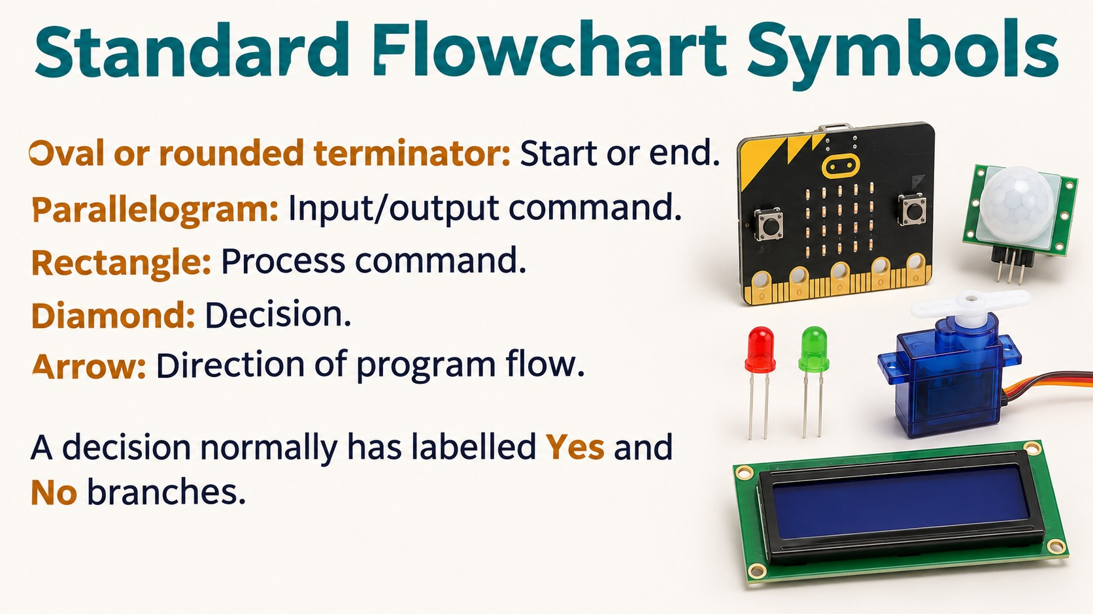
Notes:
Source: Pearson Edexcel GCSE (9–1) Design and Technology reference PDF, section 1.6 Electronic systems, printed pages 23–24, and section 1.7 The use of programmable components, pages 24–26. Classroom adaptation of approved content. Generated visuals are illustrative and are not wiring instructions. High/Low output behaviour and Wait units depend on the controller and software.

Slide 8
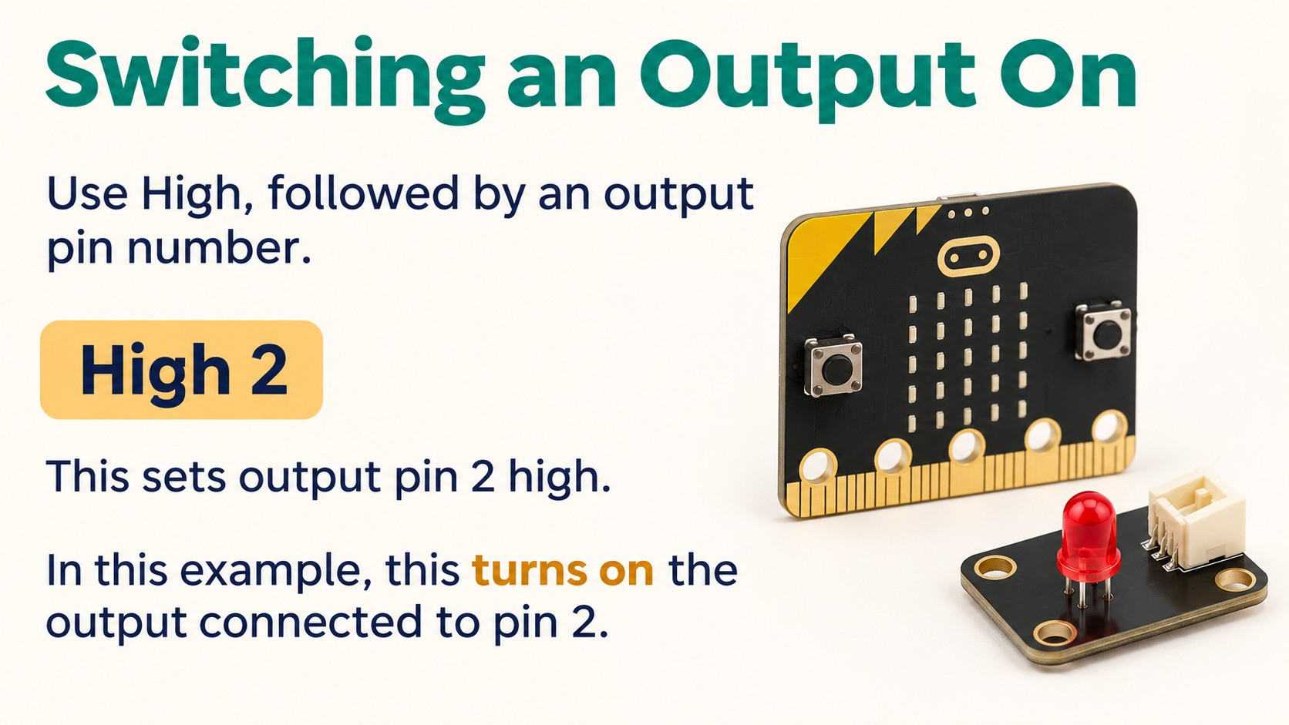
Notes:
Source: Pearson Edexcel GCSE (9–1) Design and Technology reference PDF, section 1.6 Electronic systems, printed pages 23–24, and section 1.7 The use of programmable components, pages 24–26. Classroom adaptation of approved content. Generated visuals are illustrative and are not wiring instructions. High/Low output behaviour and Wait units depend on the controller and software.

Slide 9
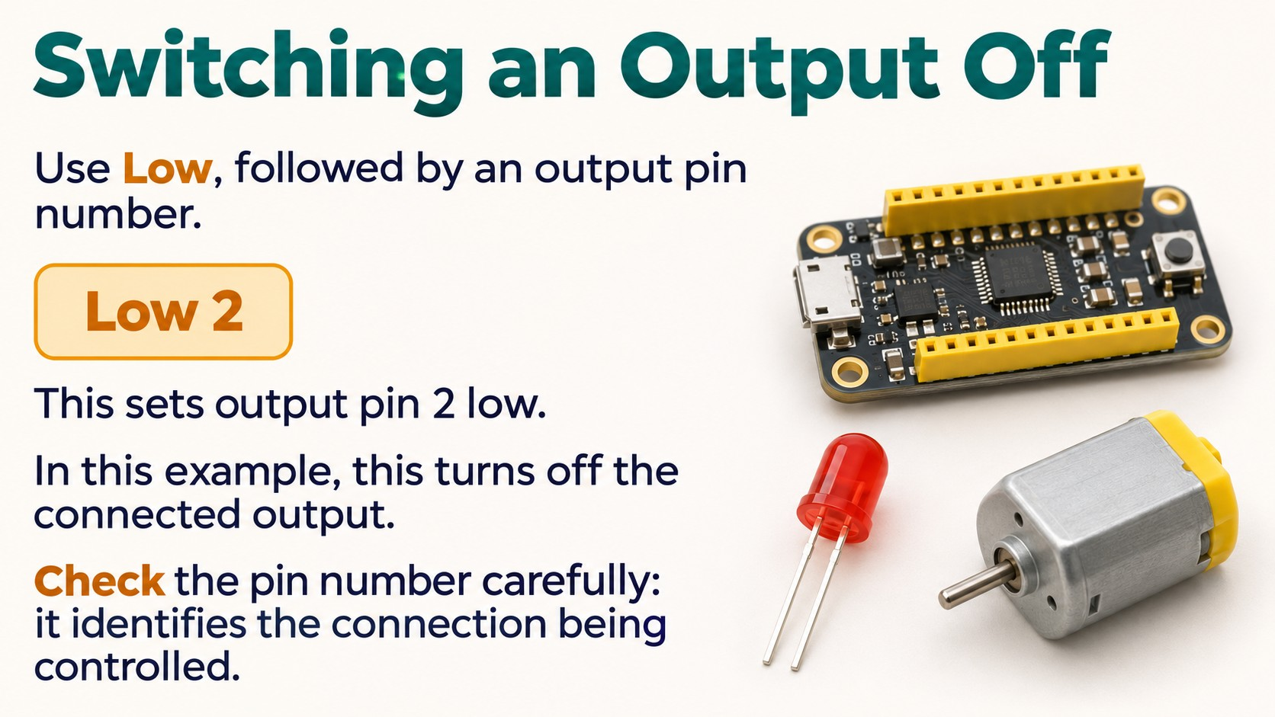
Notes:
Source: Pearson Edexcel GCSE (9–1) Design and Technology reference PDF, section 1.6 Electronic systems, printed pages 23–24, and section 1.7 The use of programmable components, pages 24–26. Classroom adaptation of approved content. Generated visuals are illustrative and are not wiring instructions. High/Low output behaviour and Wait units depend on the controller and software.

Slide 10
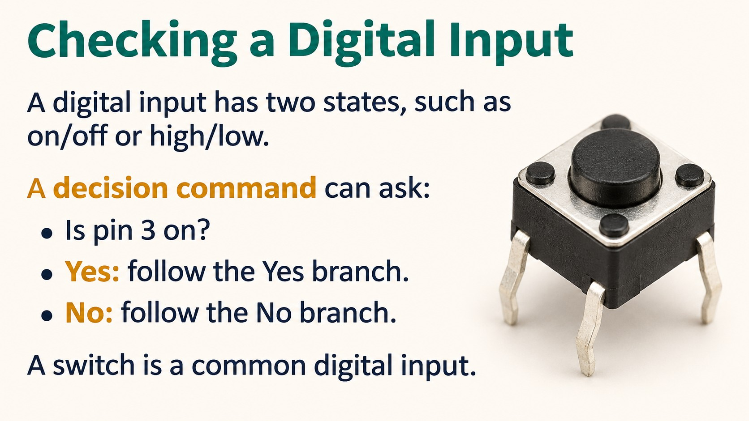
Notes:
Source: Pearson Edexcel GCSE (9–1) Design and Technology reference PDF, section 1.6 Electronic systems, printed pages 23–24, and section 1.7 The use of programmable components, pages 24–26. Classroom adaptation of approved content. Generated visuals are illustrative and are not wiring instructions. High/Low output behaviour and Wait units depend on the controller and software.

Slide 11
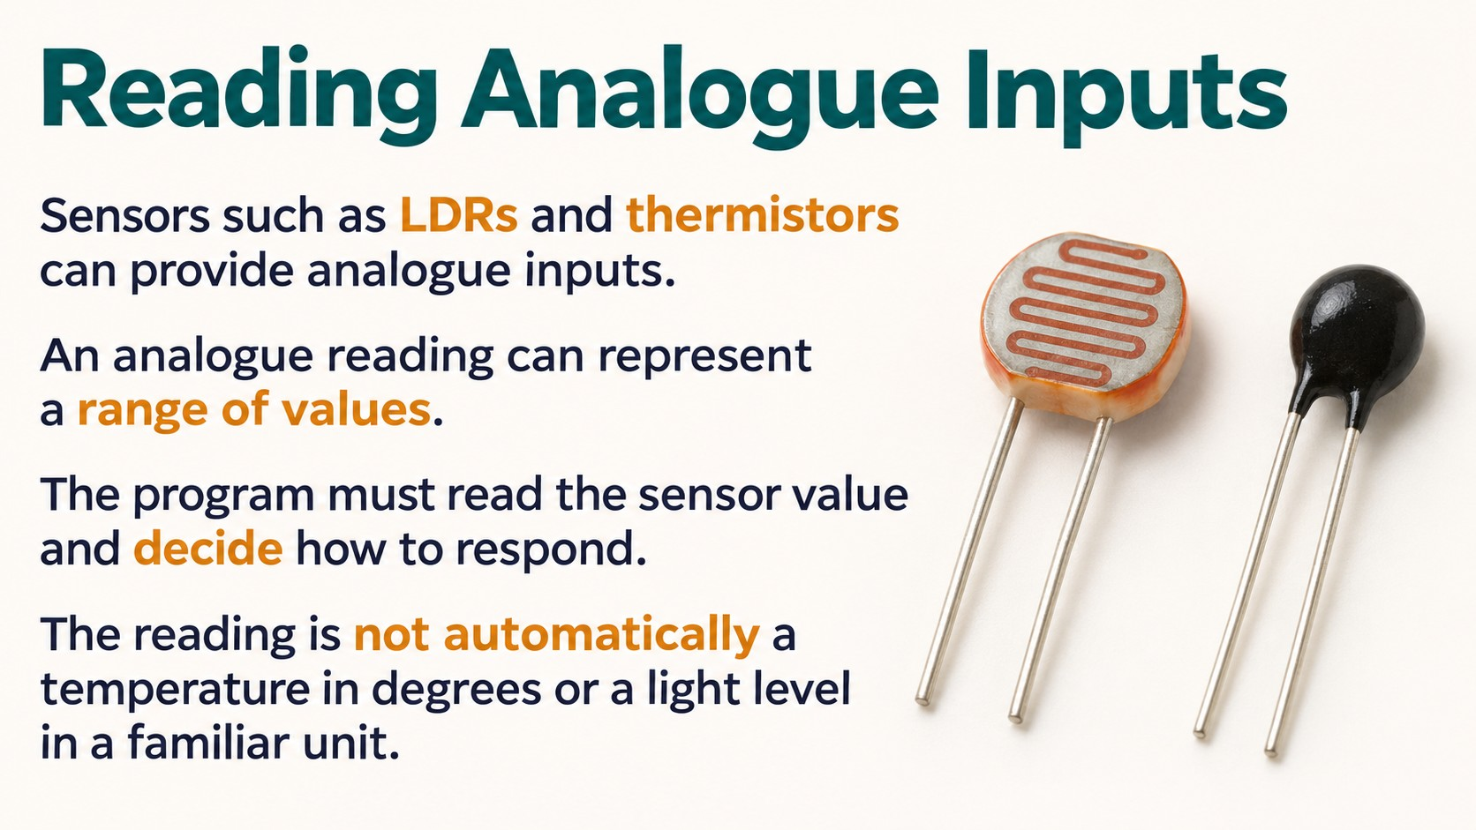
Notes:
Source: Pearson Edexcel GCSE (9–1) Design and Technology reference PDF, section 1.6 Electronic systems, printed pages 23–24, and section 1.7 The use of programmable components, pages 24–26. Classroom adaptation of approved content. Generated visuals are illustrative and are not wiring instructions. High/Low output behaviour and Wait units depend on the controller and software.

Slide 12
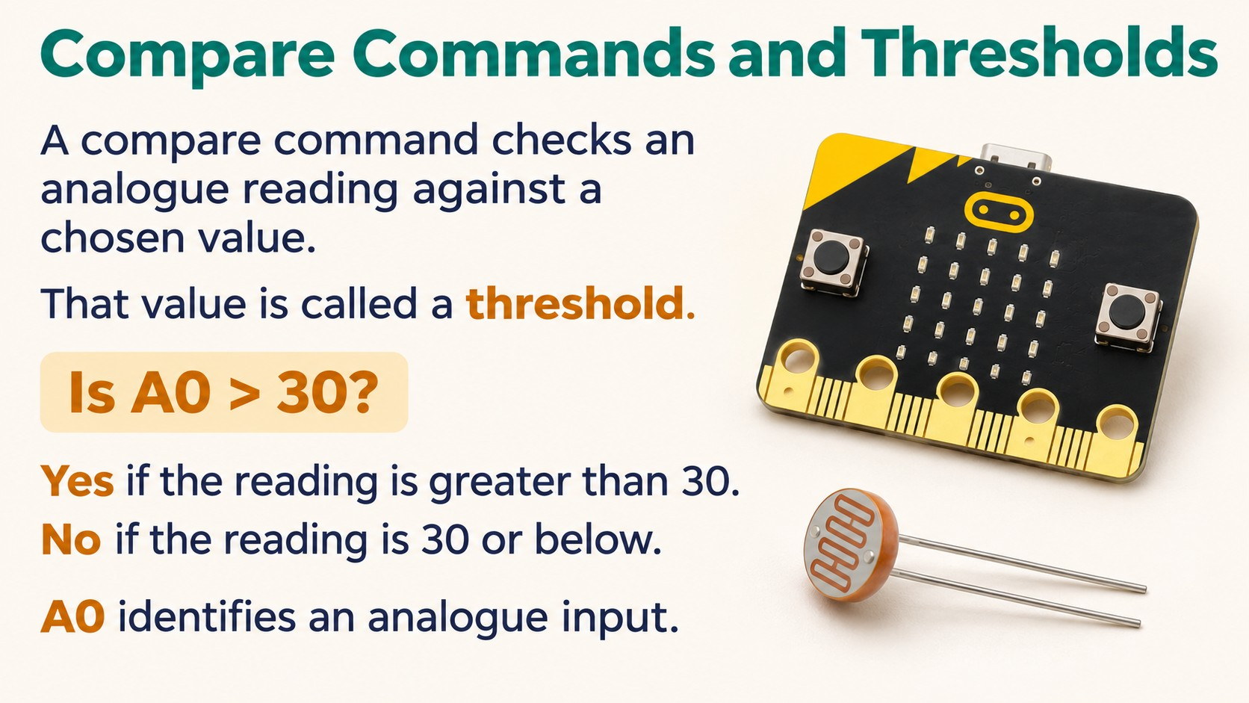
Notes:
Source: Pearson Edexcel GCSE (9–1) Design and Technology reference PDF, section 1.6 Electronic systems, printed pages 23–24, and section 1.7 The use of programmable components, pages 24–26. Classroom adaptation of approved content. Generated visuals are illustrative and are not wiring instructions. High/Low output behaviour and Wait units depend on the controller and software.

Slide 13
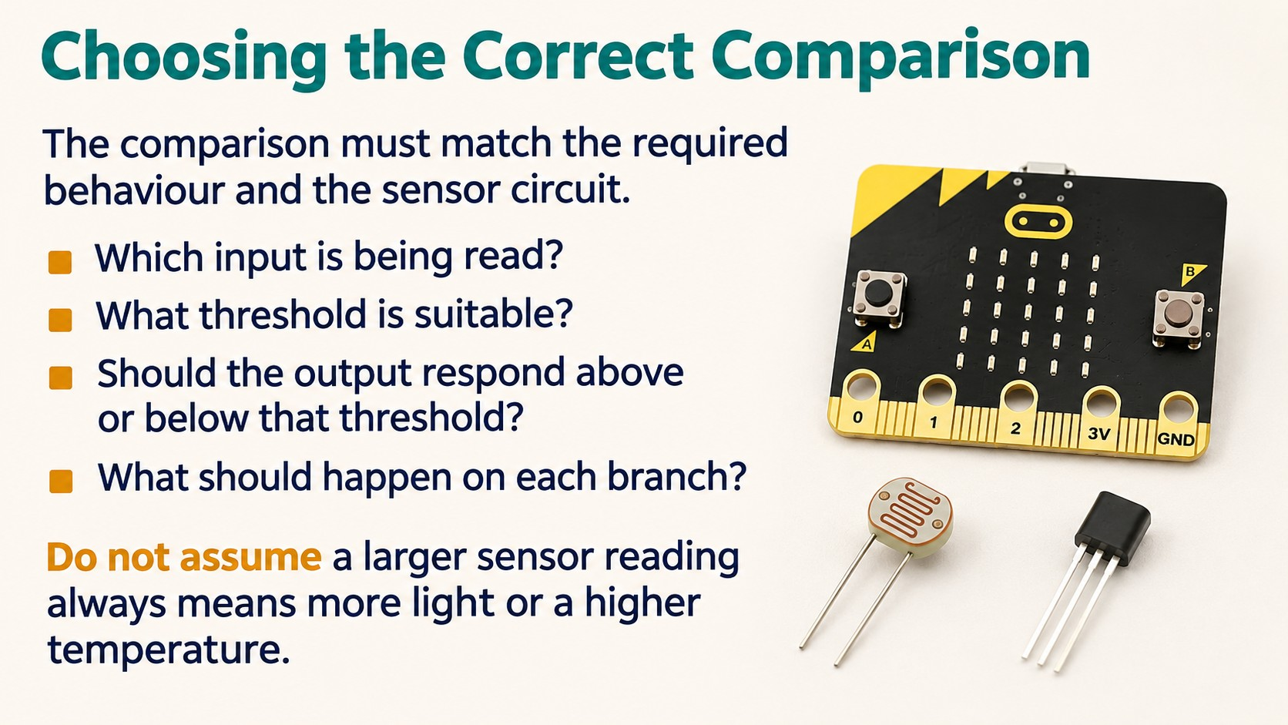
Notes:
Source: Pearson Edexcel GCSE (9–1) Design and Technology reference PDF, section 1.6 Electronic systems, printed pages 23–24, and section 1.7 The use of programmable components, pages 24–26. Classroom adaptation of approved content. Generated visuals are illustrative and are not wiring instructions. High/Low output behaviour and Wait units depend on the controller and software.

Slide 14
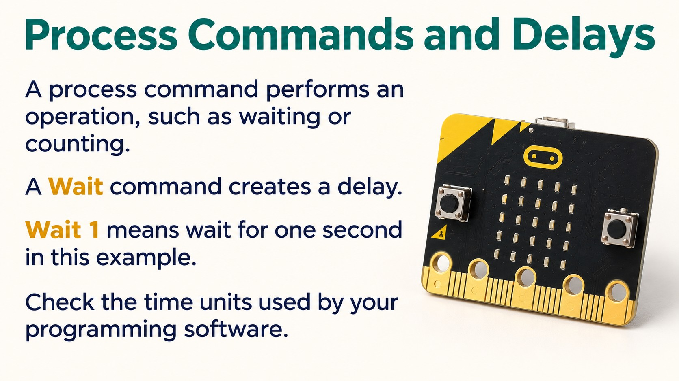
Notes:
Source: Pearson Edexcel GCSE (9–1) Design and Technology reference PDF, section 1.6 Electronic systems, printed pages 23–24, and section 1.7 The use of programmable components, pages 24–26. Classroom adaptation of approved content. Generated visuals are illustrative and are not wiring instructions. High/Low output behaviour and Wait units depend on the controller and software.

Slide 15
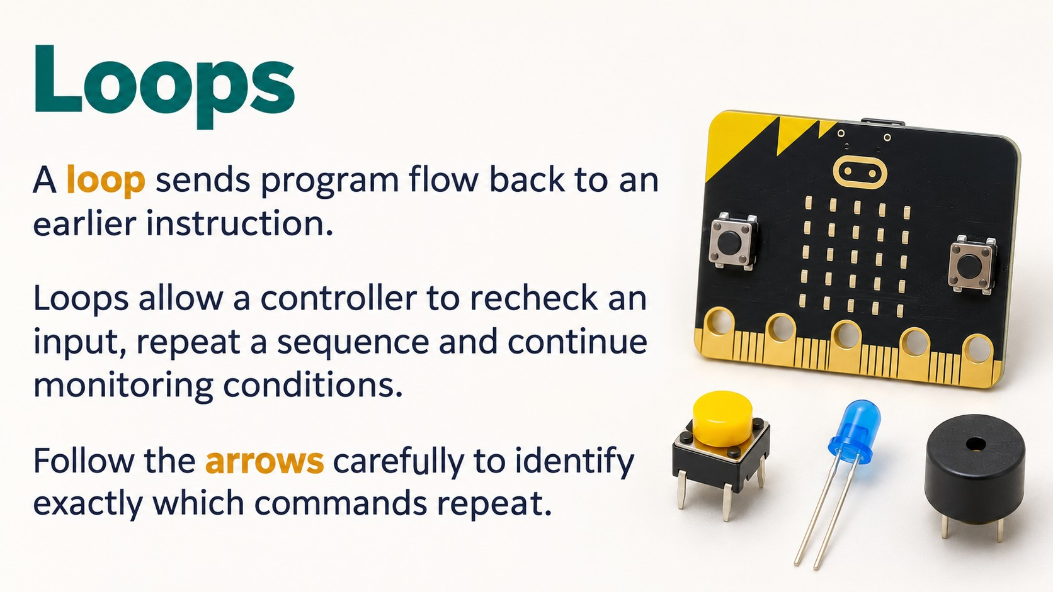
Notes:
Source: Pearson Edexcel GCSE (9–1) Design and Technology reference PDF, section 1.6 Electronic systems, printed pages 23–24, and section 1.7 The use of programmable components, pages 24–26. Classroom adaptation of approved content. Generated visuals are illustrative and are not wiring instructions. High/Low output behaviour and Wait units depend on the controller and software.

Slide 16
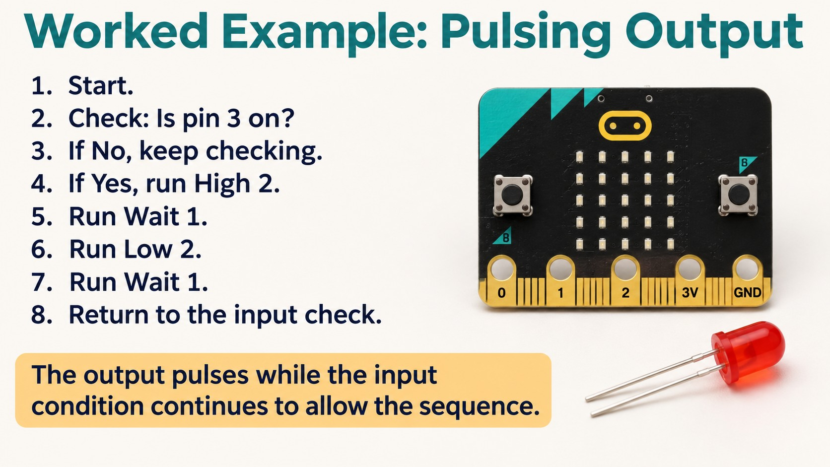
Notes:
Source: Pearson Edexcel GCSE (9–1) Design and Technology reference PDF, section 1.6 Electronic systems, printed pages 23–24, and section 1.7 The use of programmable components, pages 24–26. Classroom adaptation of approved content. Generated visuals are illustrative and are not wiring instructions. High/Low output behaviour and Wait units depend on the controller and software.

Slide 17
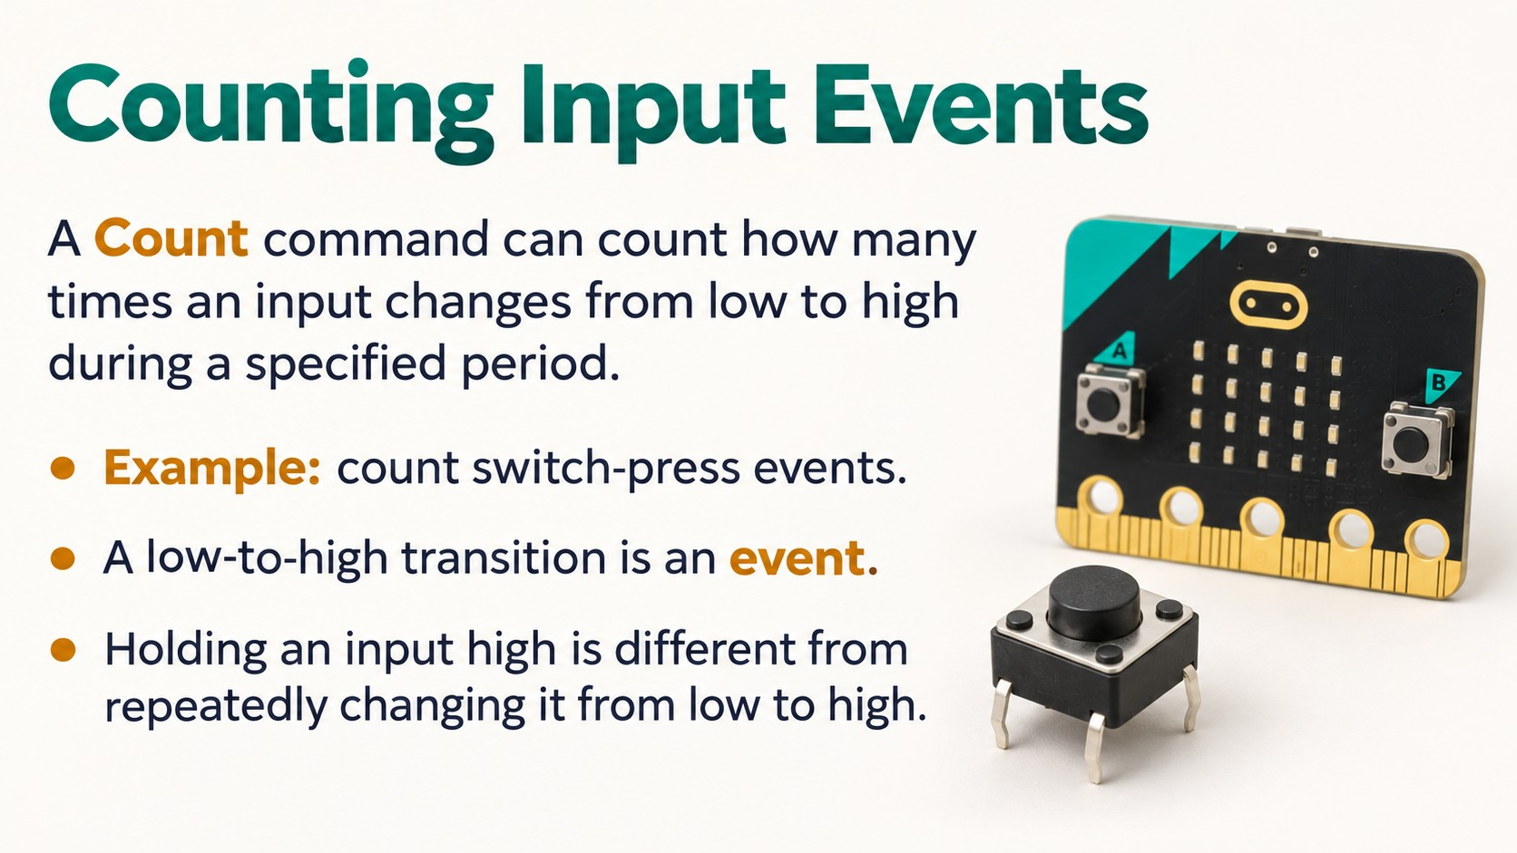
Notes:
Source: Pearson Edexcel GCSE (9–1) Design and Technology reference PDF, section 1.6 Electronic systems, printed pages 23–24, and section 1.7 The use of programmable components, pages 24–26. Classroom adaptation of approved content. Generated visuals are illustrative and are not wiring instructions. High/Low output behaviour and Wait units depend on the controller and software.

Slide 18
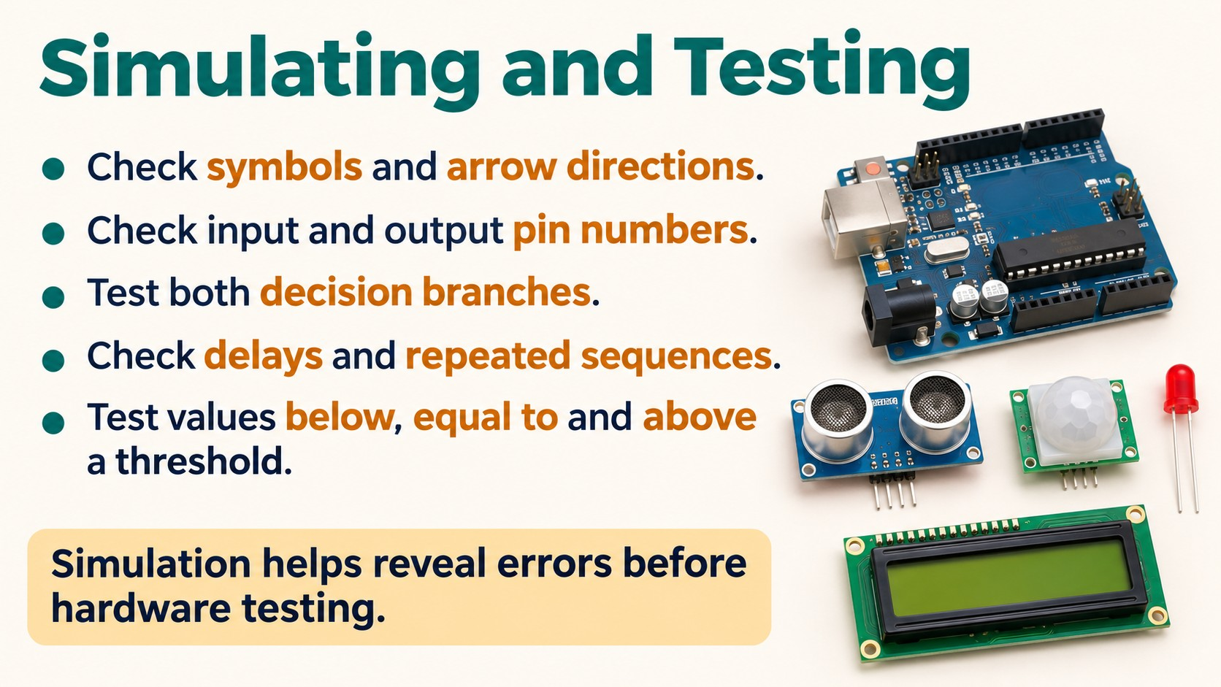
Notes:
Source: Pearson Edexcel GCSE (9–1) Design and Technology reference PDF, section 1.6 Electronic systems, printed pages 23–24, and section 1.7 The use of programmable components, pages 24–26. Classroom adaptation of approved content. Generated visuals are illustrative and are not wiring instructions. High/Low output behaviour and Wait units depend on the controller and software.

Slide 19
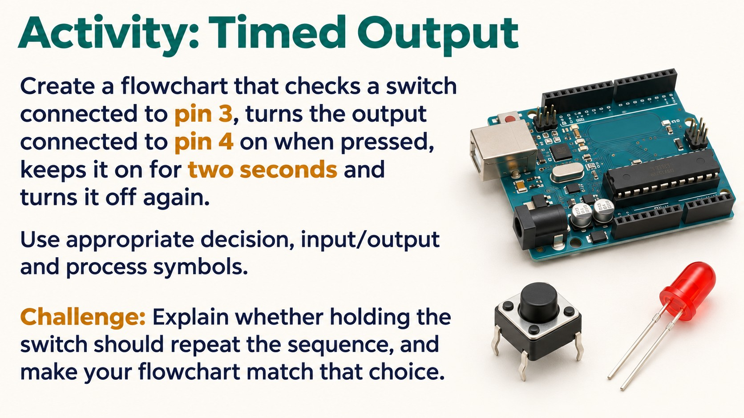
Notes:
Source: Pearson Edexcel GCSE (9–1) Design and Technology reference PDF, section 1.6 Electronic systems, printed pages 23–24, and section 1.7 The use of programmable components, pages 24–26. Classroom adaptation of approved content. Generated visuals are illustrative and are not wiring instructions. High/Low output behaviour and Wait units depend on the controller and software.

Slide 20
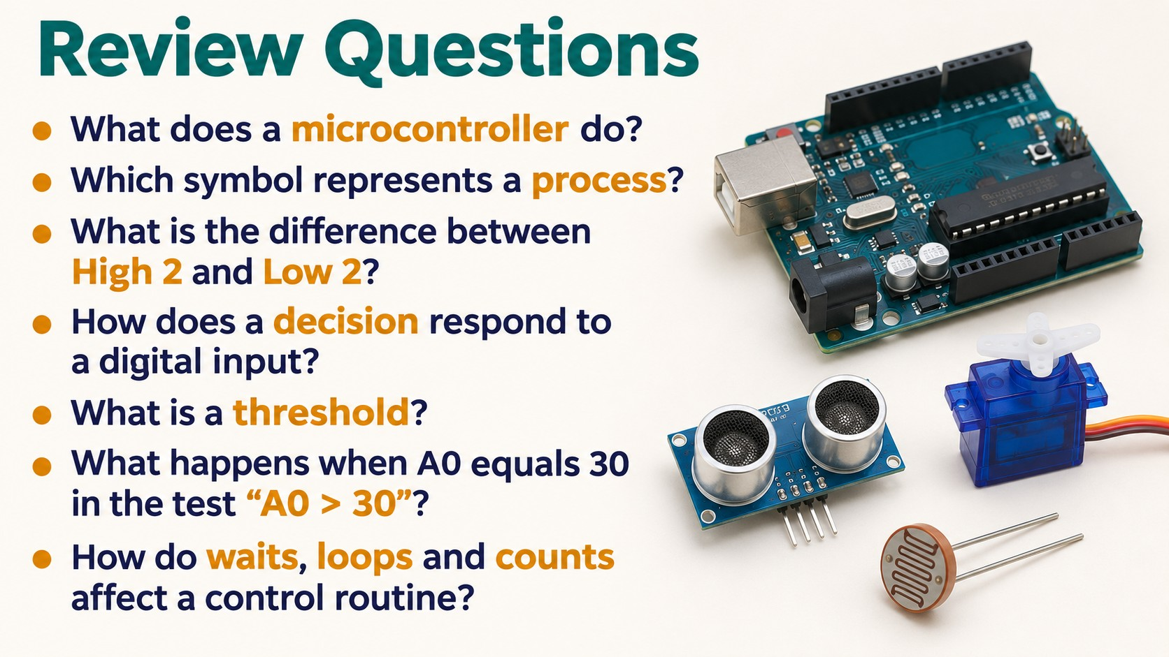
Notes:
Source: Pearson Edexcel GCSE (9–1) Design and Technology reference PDF, section 1.6 Electronic systems, printed pages 23–24, and section 1.7 The use of programmable components, pages 24–26. Classroom adaptation of approved content. Generated visuals are illustrative and are not wiring instructions. High/Low output behaviour and Wait units depend on the controller and software.

